Slide 1

Orientation to
USDA Rural Development’s
Self-Help Housing Program
RD is working to comply fully with the President's Executive Orders. Additional comments may be forthcoming that will require further revision to this presentation.
Prepared by T&MA Contractors
December 2024

Slide 2



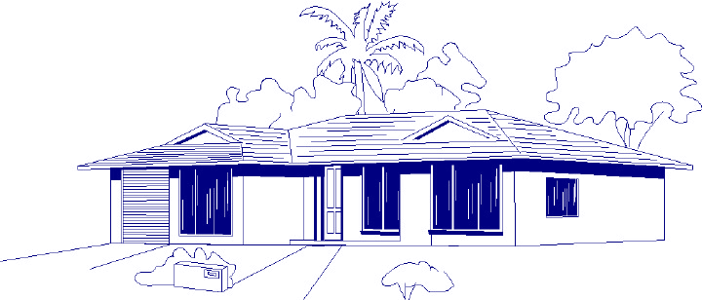
T&MA Contractors
FLORIDA NON-PROFIT HOUSING, INC.

Slide 3
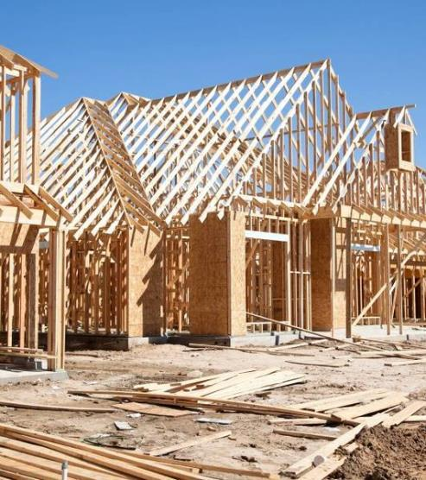

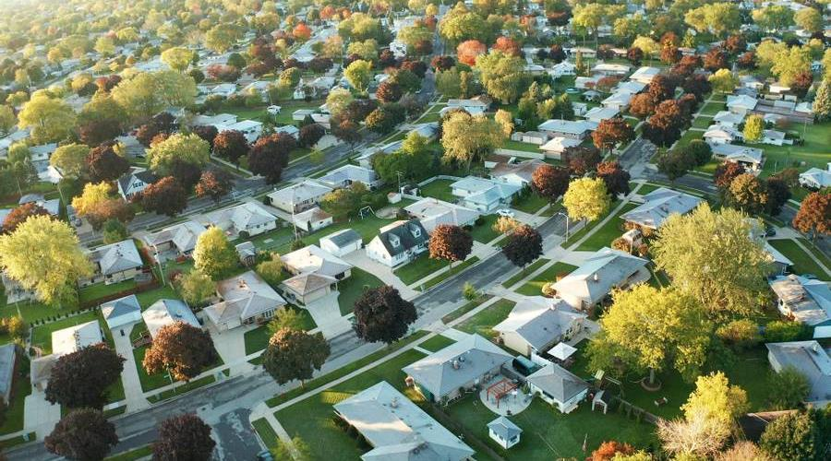
Agenda
Overview of Program
New Construction
Rehab
Benefits
Guidance and Instruction
Grant Requirements / Application
502 Loan Overview
T&MA Contractors
What Now?

Slide 4


What is Self-Help Housing?
A method for low and very low-income households to achieve homeownership
Families working to build or repair their own homes
Affordable financing
A private, non-profit housing authority or tribal entity

Slide 5

Self-Help Housing
Similar to the barn raising method used when pioneering rural America.
USDA Rural Development began funding mortgages through their 502 program in the 1960’s.
In 1971 Rural Development began the 523 Grant Program.
Over 60,000 homes have been successfully built or repaired through this method.
At one time, all 50 states have participated.
Self-Help must be in a rural area as defined by USDA Rural Development.

Slide 6
Elements of Self-Help Housing
Two-year grant periods.
Grant Amount determined by number of homes to be built and the equivalent value of a modest home.
Requires accurate reports, annual audits, cost allocation, sound bookkeeping and financial management policies.
Helpful experience for a 523 grant application includes: construction, 502 loan packaging, project management, housing development, land development, and organizational management.
Authorized 523 grant uses include staff salaries/benefits, office expenses, tools, audits/accounting system, travel, advertising and participant recruitment.

Slide 7
Self-Help Housing-Participants
Must be low or very low income.
Must qualify for a mortgage for new construction or rehab loan or grant.
Opportunity to own an affordable, energy efficient and attractive home.
Invest in a home versus renting, building a long-term asset.
Mortgage is reduced through sweat equity, with savings varying by participant.
Gain valuable skills which can enhance employment opportunities and learn skills to assist in home maintenance.
Contributes to building strong neighborhoods
and communities.

Slide 8

Self-Help Community Benefits
Creates affordable housing opportunities.
Provides access to affordable mortgages.
Homeownership boosts the local tax base.
Brings in federal grant and mortgage funding.
Enhances and improves local housing stock.
Contributes to local economy.
Participants can own a home for what it costs to rent (varies by area).
Participants learn valuable construction and maintenance skills.
Self-Help can build wealth and equity.
USDA Rural Development involvement may lead to additional opportunities.

Slide 9
Self-Help Agency Benefits
Supports the organization’s mission.
Creates a new revenue stream.
Offers program flexibility.
Generates excitement with new programs and partners and stakeholders.
Provides opportunities for staff support and new positions.
Builds and strengthens organizational capacity.
Could lead to other USDA Rural Development funding opportunities.

Slide 10

Meet the Team--Four Necessary Elements
Participants - labor
USDA Rural Development - $$
    502 (or 504) and 523 funds
Grantees -Housing corporations - organize and assist the families
T&MA Contractors - training and oversight
Orientation

Slide 11

Section 523 and 502/504 Regulations
Section 523 Mutual Self-Help Housing
7 Code of Federal Regulations (CFR) 1944 , subpart I
Rural Development Instruction 1944-I
Uniform Guidance 2 CFR 200
Section 502/504 Program Regulations
Handbook 1-3550
7 CFR 3550
Additional Guidance
Administrative Notices
Unnumbered Letters
Procedure Notices

Slide 12
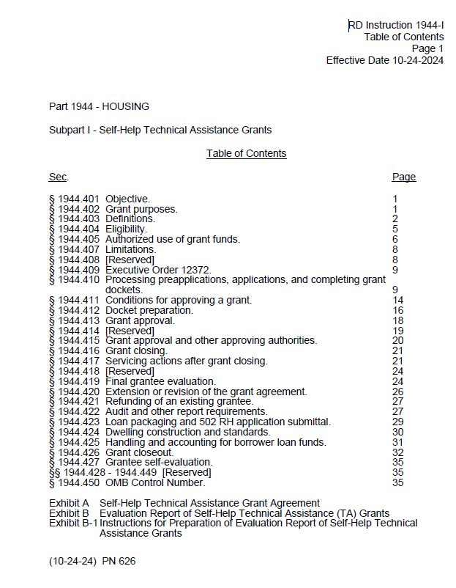
Regulations
1944-I governs the self-help housing program. All grantees should read the regs!
https://www.rd.usda.gov/sites/default/files/1944i_0.pdf

Slide 13

Types of Self-Help Housing
New Construction
Rehab
Acquisition Rehab
Owner-Occupied Rehab

Slide 14

New Construction

Slide 15
Mutual Self-Help Housing - New Construction
Families work together in groups of 4-10 to build their home, contributing 65% of the labor tasks under the supervision of a construction supervisor as outlined in Exhibit B-2.
Houses start and finish construction together.
No one moves in until all homes are finished and approved.
Work is done by the participants in the evenings, on weekends and days off.
Self-help construction is a commitment of time and labor.

Slide 16

How long will it take to build the homes?
The total process takes 11 to 16 months
  3 to 4 months in pre-construction
  8 to 12 months in construction

Slide 17
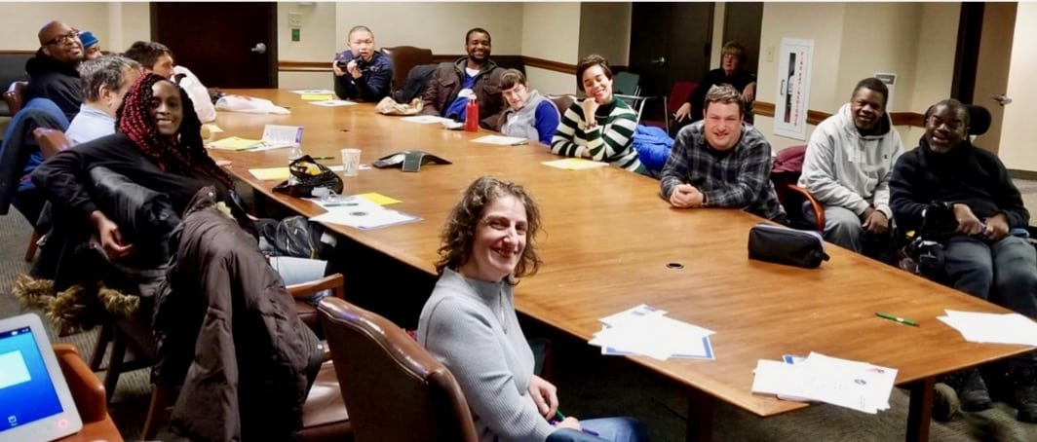
Pre-Construction Tasks
Choosing house plans
Selecting building sites
Completing Rural
Development paperwork
Waiting for loan approval
Participating in Pre-Construction Meetings—Key to success
Education

Slide 18
Family Labor Contribution
Families contribute as much labor as is required to complete ALL of the houses in the group
Families must complete a minimum of 65% of the construction labor tasks
Technical work such as foundation, plumbing, heating and electrical is subcontracted out
Generally, each family contributes 30 to 35 hours each week
Family hours include the labor of either spouse
Volunteer labor is allowed with approval from USDA Rural Development

Slide 19
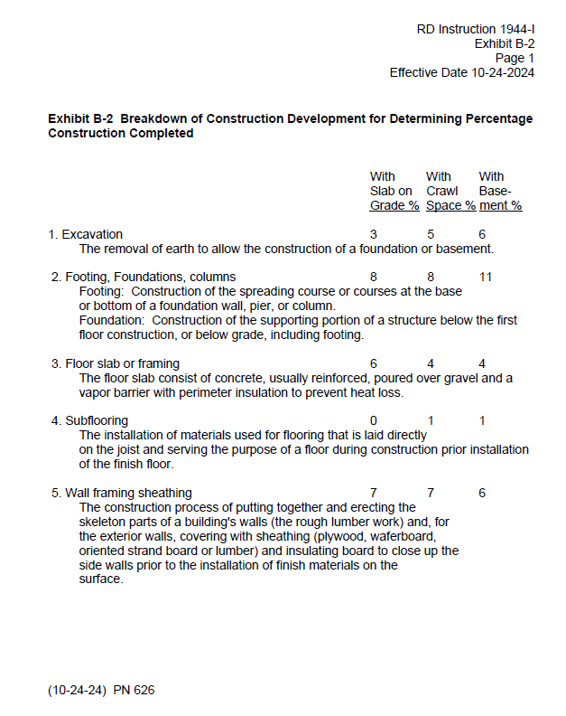
Mutual Self-Help Housing New Construction
Exhibit B-2

Slide 20
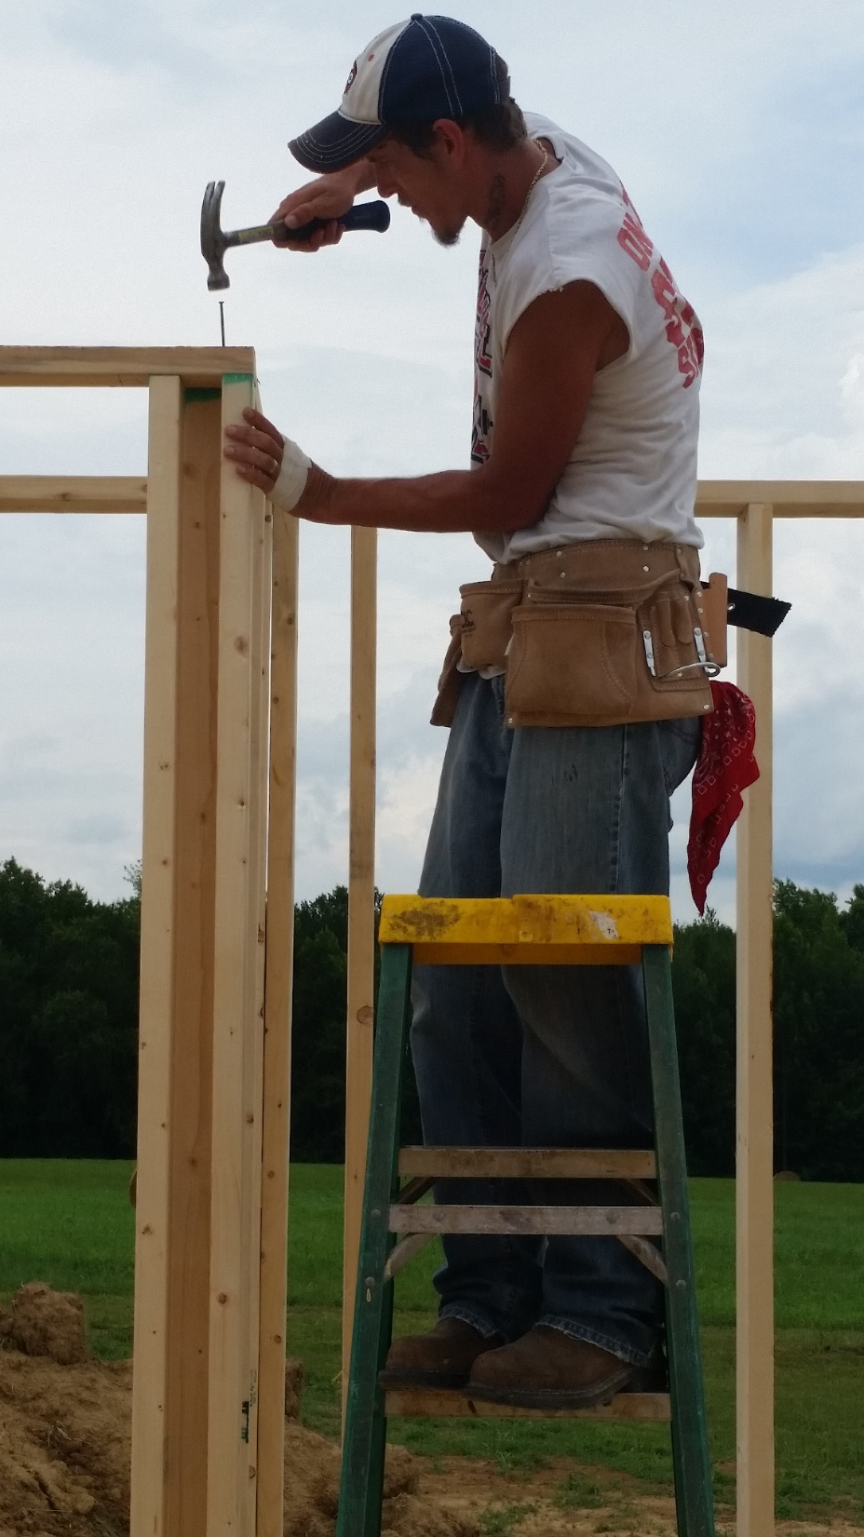
Some tasks participants can include:
  excavation
  framing
  setting of trusses
  roofing
  insulation
  sheathing
  siding
  windows & doors
  drywall
  painting
  interior trim & cabinets
  flooring install
  landscaping

Slide 21
Rehab

Slide 22

Self-Help Rehab
Self-Help Rehab is allowed in regulations.
Labor is not mutual.
Acquisition Rehab or Owner-Occupied Rehab.
      Either or a combination
Rehab grants can be combined with New Construction grants.

Slide 23

Elements of Rehab
USDA RD recommends the homeowner contributes a minimum of 10 hours for every $1,000 on repairs not completed by subcontractors.
Repairs will be completed over an 8-12 week period, though this may vary.
TA that is provided by the grantee includes:
  Assisting with applying for funds
  Training participants in tasks
  Managing and paying bills

Slide 24
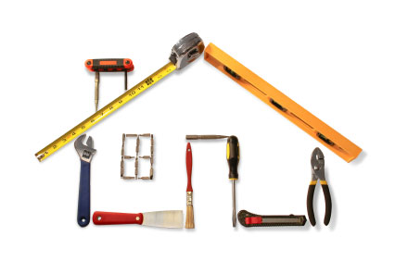
Elements of Repairs for Rehab
Repairs - Each home will be inspected on an individual basis with repairs that will vary
  Health and safety repairs first
  Energy efficiency issues next
  Cosmetic issues last
Tip-Seek homes constructed post January 1, 1978, that are structurally sound, but need improvements. Many homes built prior to 1978 were constructed using lead based paint as well as asbestos.

Slide 25
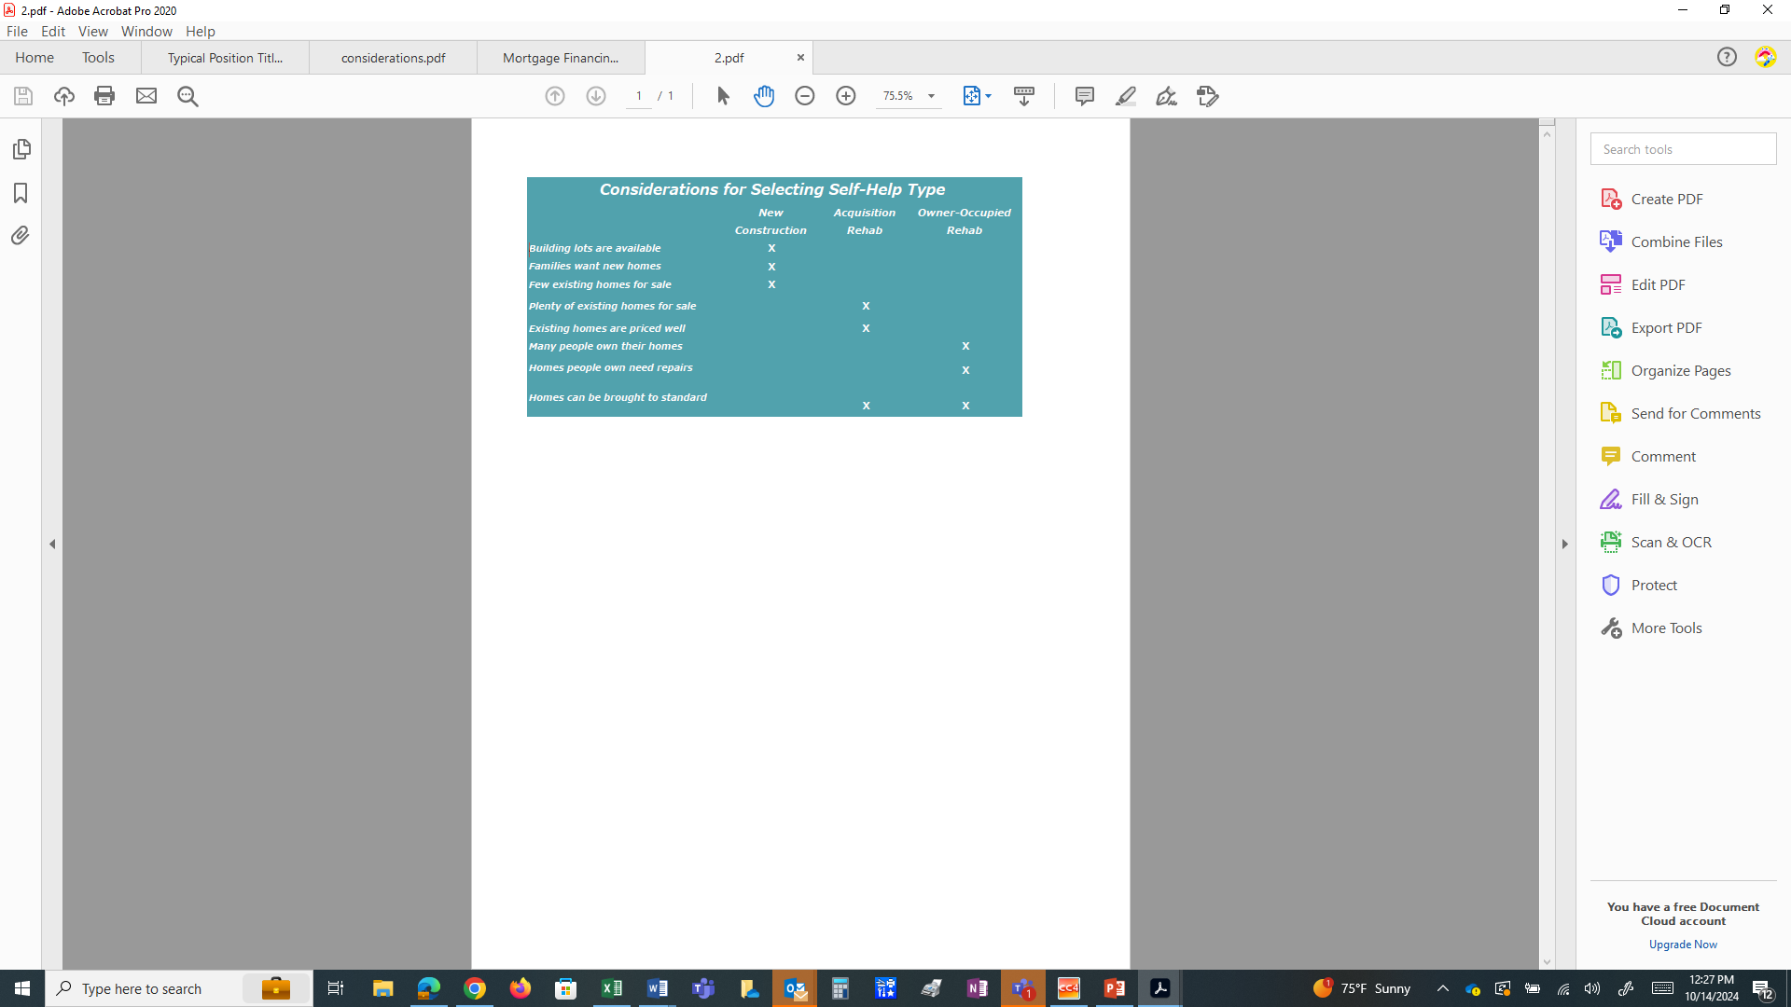
Considerations for Selecting Self-Help Type
With USDA Approval, an organization may propose to do a mix of new construction and rehabilitation based on the local housing market and needs.
When considering which type you may want to operate, consider this list for guidance.
Additionally, the Feasibility Handbook will provide valuable insight to assist your organization with making an informed decision.

Slide 26
Program Comparison
Mutual
Group labor of generally 4-10 families
Contribute at least 65% labor
Families move in at same time
Affordable financing
Contributes to stable economy
Rehab
  No group labor
  10 hours for every $1,000 in non contracted costs
  Families generally live in home during the rehab project

Slide 27
Self-Help Technical Assistance Grant
Purpose:
Provide technical assistance and supervision to low and very low-income families to construct, repair, and/or rehab a home.
To pay administrative costs associated with operating a self-help program.
Generally, grants may not exceed 24 months. An extension of no more than 1 year may be granted if clearly justified.
  https://www.rd.usda.gov/programs-services/single-family-housing-programs/mutual-self-help-housing-technical-assistance-grants

Slide 28

Who Qualifies for a Grant and Requirements
501 C (3) Non-Profit
Housing Authority or Tribal Entity
Public Bodies
Rural Areas as designated by USDA Rural Development.
Meet Program Performance Goals.

Slide 29
Grant Amount for New Construction
Determined by the number of homes to be built for new construction.
New construction-typically 15% of the Equivalent Value of Modest Housing (EVMH) as determined by USDA Rural Development.
    EVMH X 15% = TA Cost X # of proposed homes = TA Grant Amount

Slide 30
Grant Amount for Rehabilitation
Determined by the number of homes to be rehabilitated.
Rehabilitation-negotiated between the applicant and USDA Rural Development.
1 complete project = 1 EU.

Slide 31
Use of TA Grant Funds
Authorized expenses:
Personnel salaries
Reasonable office expenses and supplies
Employment benefit costs
Purchase or lease of power tools
Insurance
Reasonable fees for training
Consultant and legal fees
Annual audits
Prohibited use of funds:
Paying for labor on the houses
Purchasing real estate or building materials for the families
Paying any debts, expenses or costs to the participants
Any lobbying activities prohibited in 2CFR 200 Subpart F

Slide 32

Skills Needed to Operate a Successful Program
Ability to communicate and coordinate objectives and goals with funding sources
Knowledge to identify housing needs of low and very low-income families in the area to be served
Understand the agency mission
Strong leadership and management
Talent to motivate participating families

Slide 33
Typical Staffing 1944.405 (h)
Full or Part time Director
Project Worker
Secretary-Bookkeeper
Construction Supervisor

Slide 34
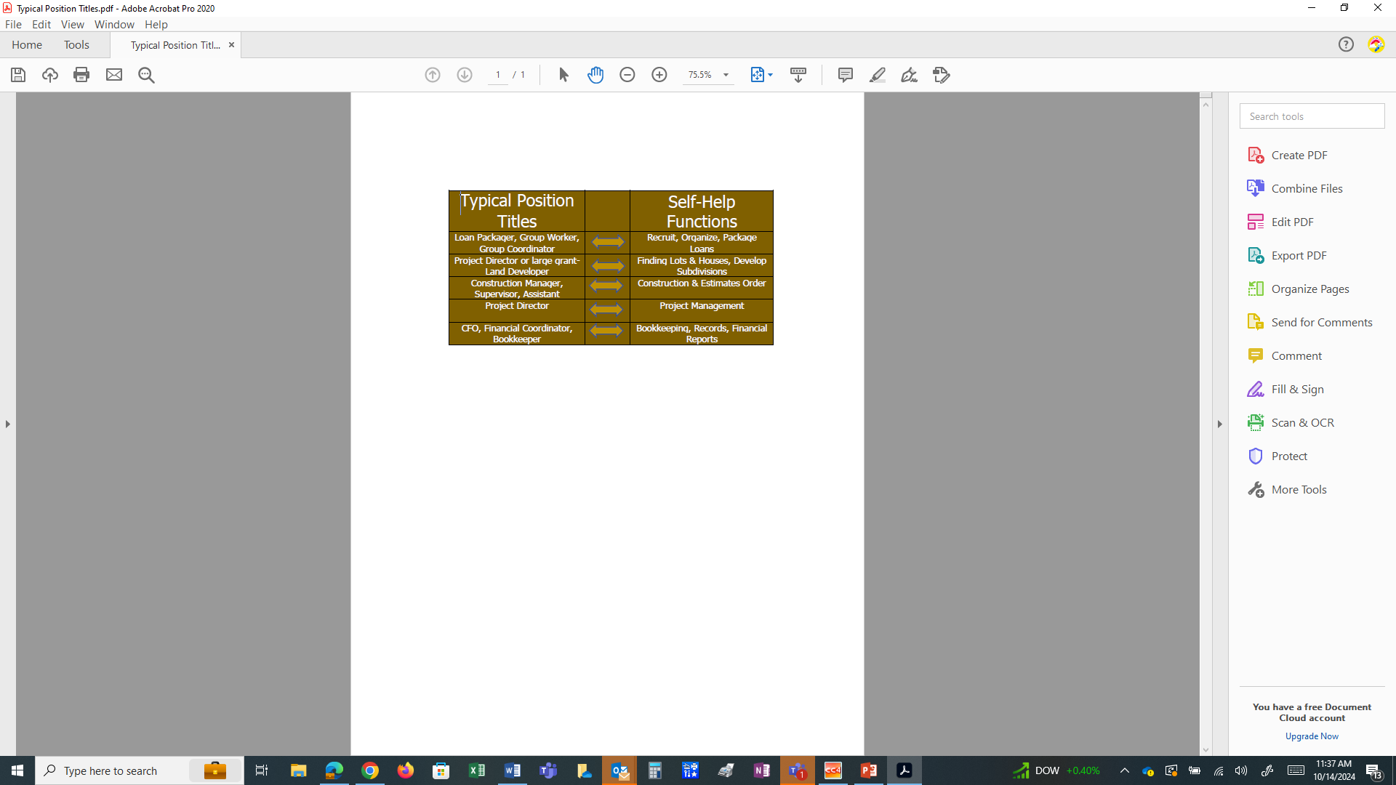
Additional Self-Help Staffing Titles

Slide 35

Board of Directors Responsibilities
Organization oversight
Financial management
Policies and Procedures
Mission and Strategic Plan
Knowledge of programs
Authorized program representative
Provides annual evaluation

Slide 36
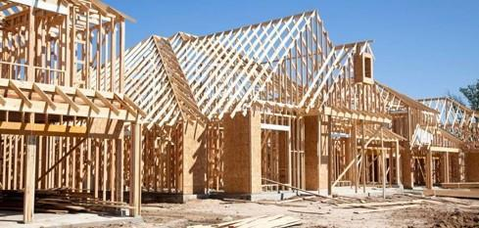


Grantee Responsibilities
Recruiting participants (40% very low income)
Conducting construction and pre-construction meetings
Locating suitable building sites or homes
Selecting house plans or Determining repairs to be made
Preparing cost estimates

Slide 37
Grantee Responsibilities
Assisting participants in applying for a 502 loan or other funding.
Subcontracting work on the participants’ behalf.
Supervising and training participants in the construction/repair of homes.
Supervising the participants’ 502 or 504 funds (or other).
Attend Quarterly Review meetings.

Slide 38



USDA Rural Development’s Responsibilities
Determine loan eligibility.
Review and Process 523, 504, and 502 Funds.
Quarterly Reviews.
Grant Evaluation.
Review grant close-out reports and activity.
This Photo by Unknown Author is licensed under CC BY

Slide 39
Participant Responsibilities
Commit to and Provide 65% labor of the construction.
Build in groups of generally 4-10 families.
Select house plans.
Work on all homes in the build group.
Willingness to learn construction tasks.
Follow the guidance of the Membership Agreement.
Need affordable housing-Home is a HIGH PRIORITY.

Slide 40

Grant Performance Goals
Must meet 3 of 5 to earn Acceptable Rating 1944-I Exhibit O.
Assist the projected number of families in obtaining adequate housing (Production Goals).
Assisting very low-income families (40% very low income).
Meeting the family labor requirement in Exhibit B-2 (65% labor completed by the families).
Meeting the projected Technical Assistance Cost.
Meeting all other grant requirements.
This Photo by Unknown Author is licensed under CC BY-SA

Slide 41
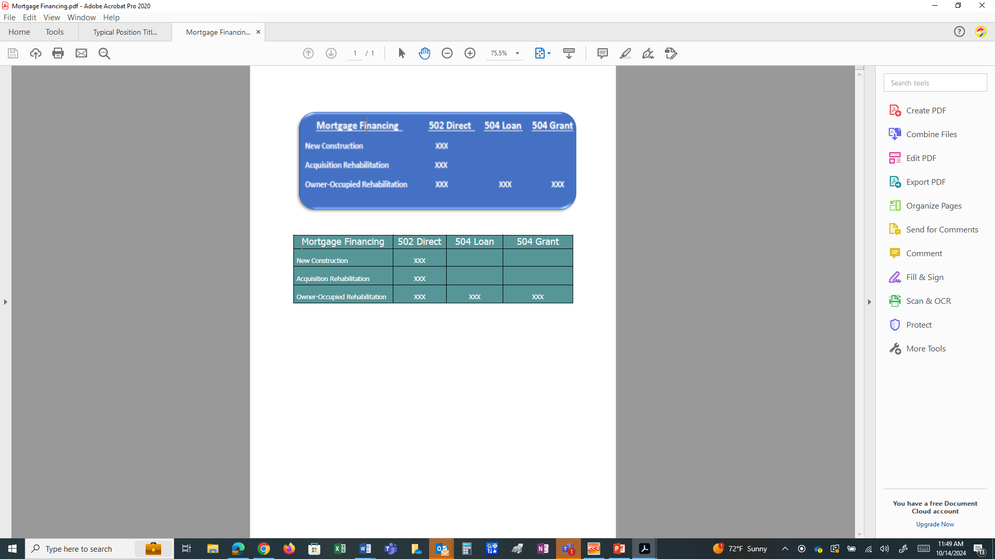
USDA Rural Development Funds
523 Grant Funds:
Funds provided by USDA Rural Development to the Grantee to administer the Self-Help program.
502/504 Funds:
Funds provided by USDA Rural Development for the families to finance the construction or rehab of their homes.

Slide 42
Financing
New Construction and Acquisition Rehab - most common source of funding is USDA Rural Development 502 Direct Loan
Owner Occupied Rehab - most common source of funding is a USDA Rural Development 504 Loan and/or Grant
    Funding can be leveraged with other funding sources to maximize loan and/or rehab
    Reduced interest rate for low and very low-income borrowers

Slide 43
USDA Rural Development 502 Direct Loan Requirements
Income eligible.
Agree to occupy the property as principal residence.
Show credit and repayment ability.
House must be modest.
Market value cannot exceed the area loan limit.
https://www.rd.usda.gov/programs-services/single-family-housing-programs/single-family-housing-direct-home-loans

Slide 44

Benefits of the 502 Loan Program
Effective interest rate can be
below market rate
Payment is based on income
and adjusted annually
Repayment period is 33 or 38 years
No down payment is required
Closing costs can be financed (up to appraised value)
No PMI is required
Interest and mortgage payments are deferred during construction

Slide 45
USDA Rural Development 504 Loan or Grant
Most commonly used resource for Owner Occupied Rehab
Maximum loan $40,000 - repair, improve, or modernize, and remove health and safety hazards (lien on property if $7,500 or more)
Interest rate of 1% and a term of 20 years
No downpayment
Maximum lifetime grant $10,000 (If qualified it can be combined with a loan to remove health and safety hazards)
Grant is for 62 and older to remove health and safety hazards, or to remodel dwellings to make it accessible to a household member with a disability
https://www.rd.usda.gov/programs-services/single-family-housing-programs/single-family-housing-repair-loans-grants

Slide 46


Application Requirements
  First group of applicants must be loan eligible (10% for rehab)
  First group’s lots have been secured
  All qualified key staff have been hired and available
  House plans, specs, & estimates complete
  Organizational documents
  Adequate accounting system
  Detailed budgets

Slide 47
Quarterly Review Meeting 1944.417
  Attended by USDA Rural Development, Grantee and T&MA Contractor.
  SHARES reports are reviewed.
  Funding status and Policy Updates discussed.
  The following Grantee performance requirements are reviewed:
    Is grantee assisting the projected number of families?
    Is grantee serving very low-income families of at least 40%?
    Is the 65% labor contribution by the families being accomplished?
    Is the grantee with the proposed TA cost – Total EU’s completed?
    Is the grantee on track?

Slide 48
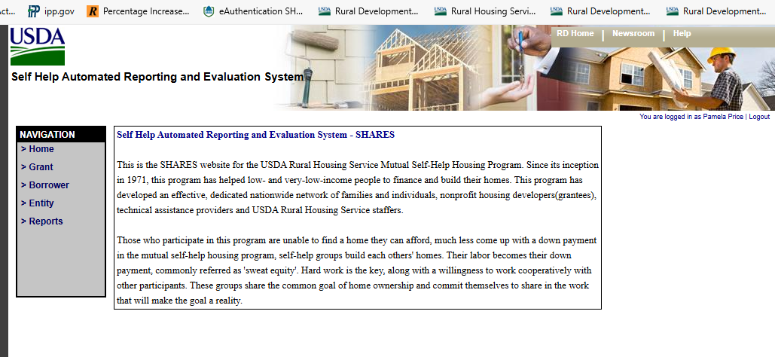
SHARES Reporting and Tracking
  Self-Help Automated Reporting and Evaluation System
  (SHARES)
    Used to track grantee progress
    Construction
    Funds

Slide 49
Repair and Rehab Reporting and Tracking
  1944-I Exhibit M is used to track grantee progress including:
    EU increase for the quarter
    Method of Rehab
    Average construction investment
    Average cost savings
    Number of houses/EUs completed
    Number of houses under Rehab
    Number of families in pre-rehab
    Average time needed to complete a rehab project
    List of adverse effects during the quarter

Slide 50
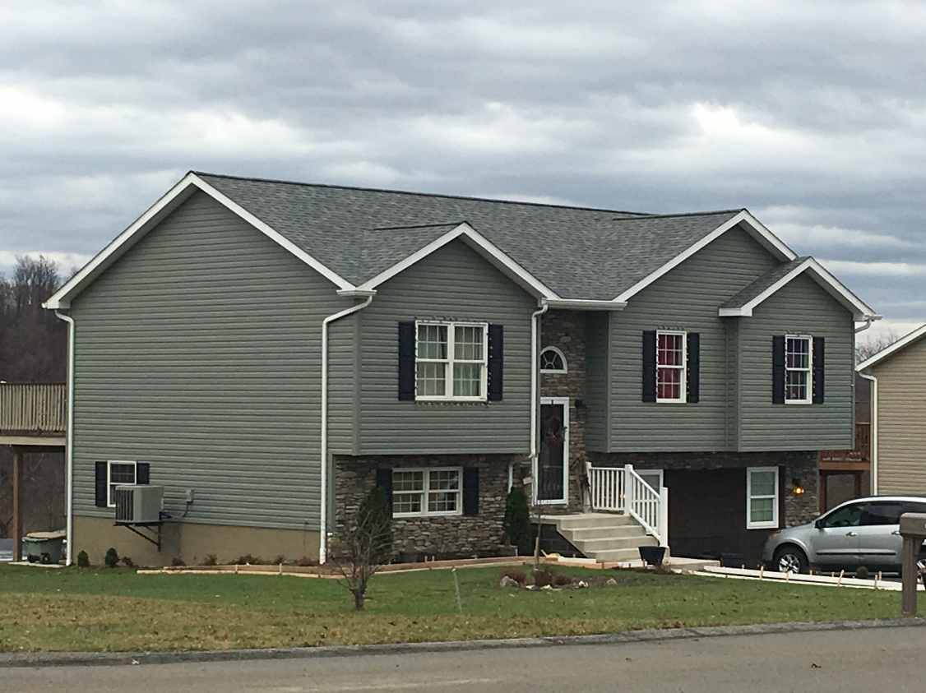
Sample Self-Help Homes
A completed home in western Pennsylvania, sponsored by Threshold Housing Development.

Slide 51
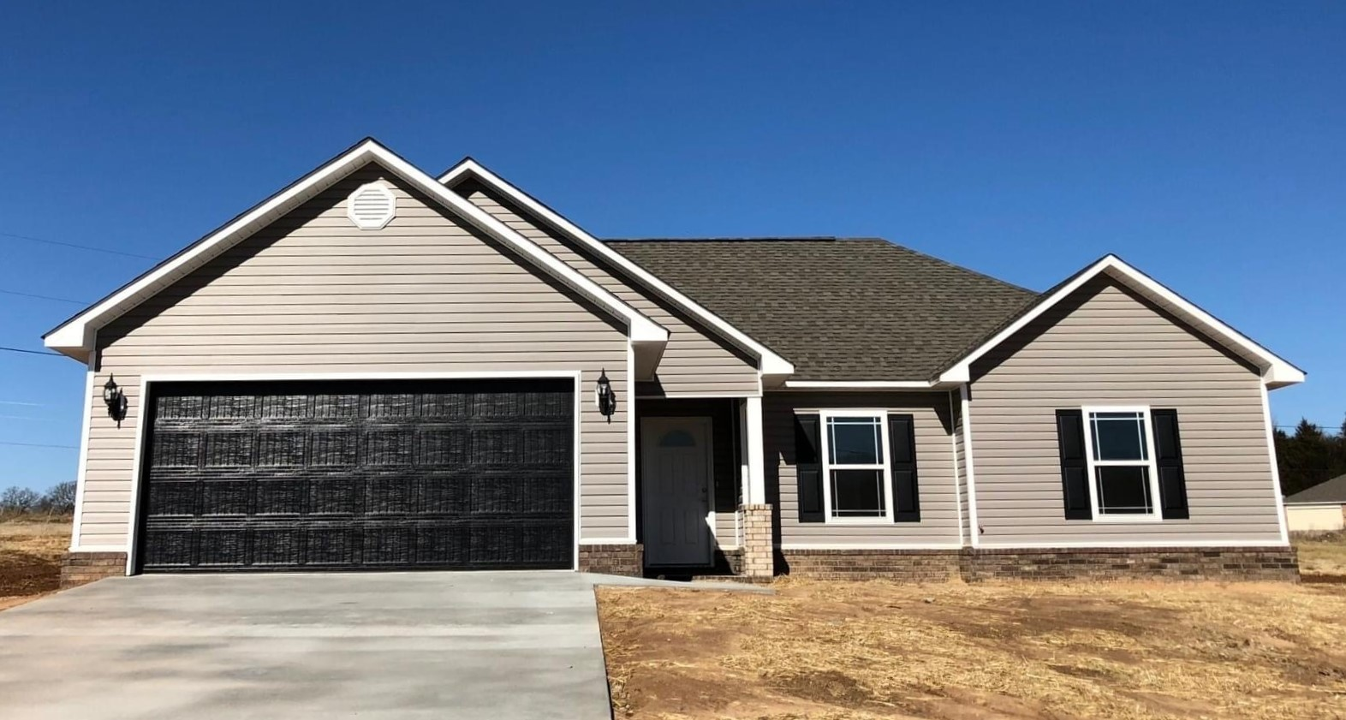
A completed home in Fort Smith, Arkansas sponsored by Crawford Sebastian CDC

Slide 52
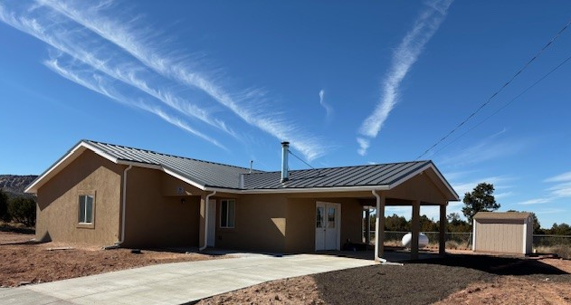
This home was completed in Zuni, New Mexico by Zuni Housing Authority.

Slide 53
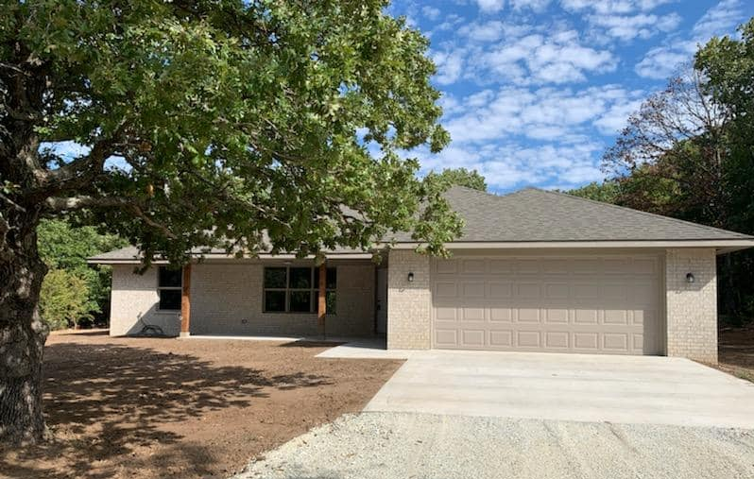
This home was completed in Ada, Oklahoma under the sponsorship of Tri-County Indian Nations CDC.

Slide 54
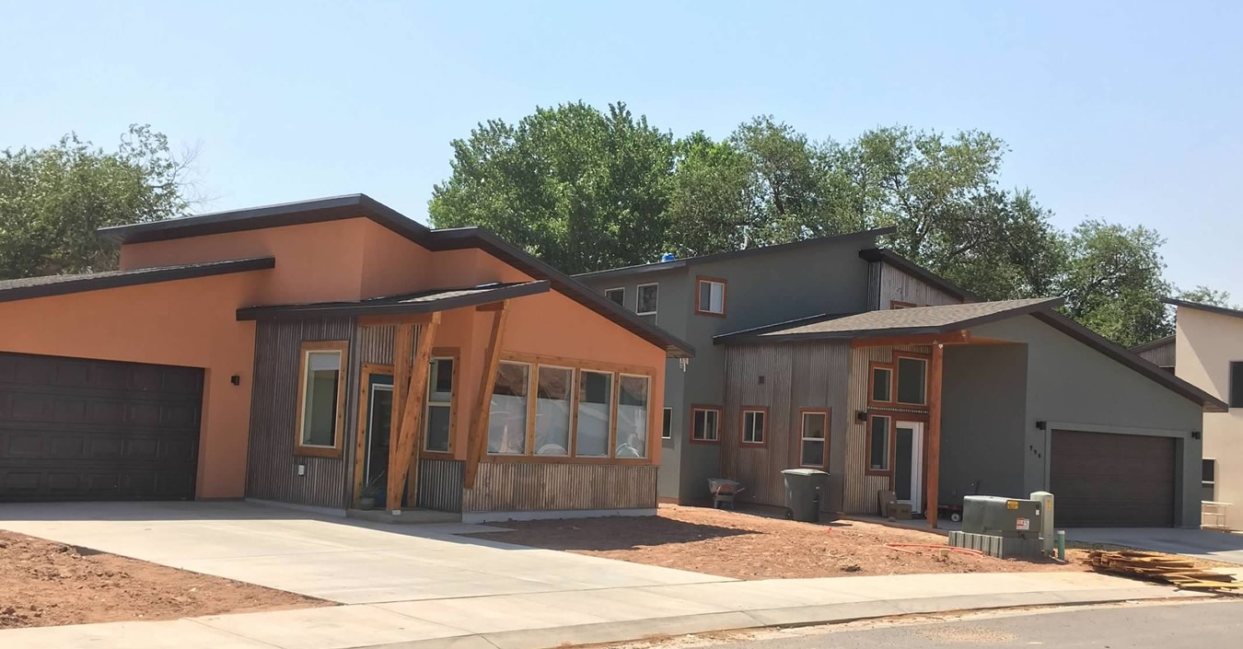
A completed home in western Moab, UT sponsored by Housing Authority of Southeastern Utah

Slide 55
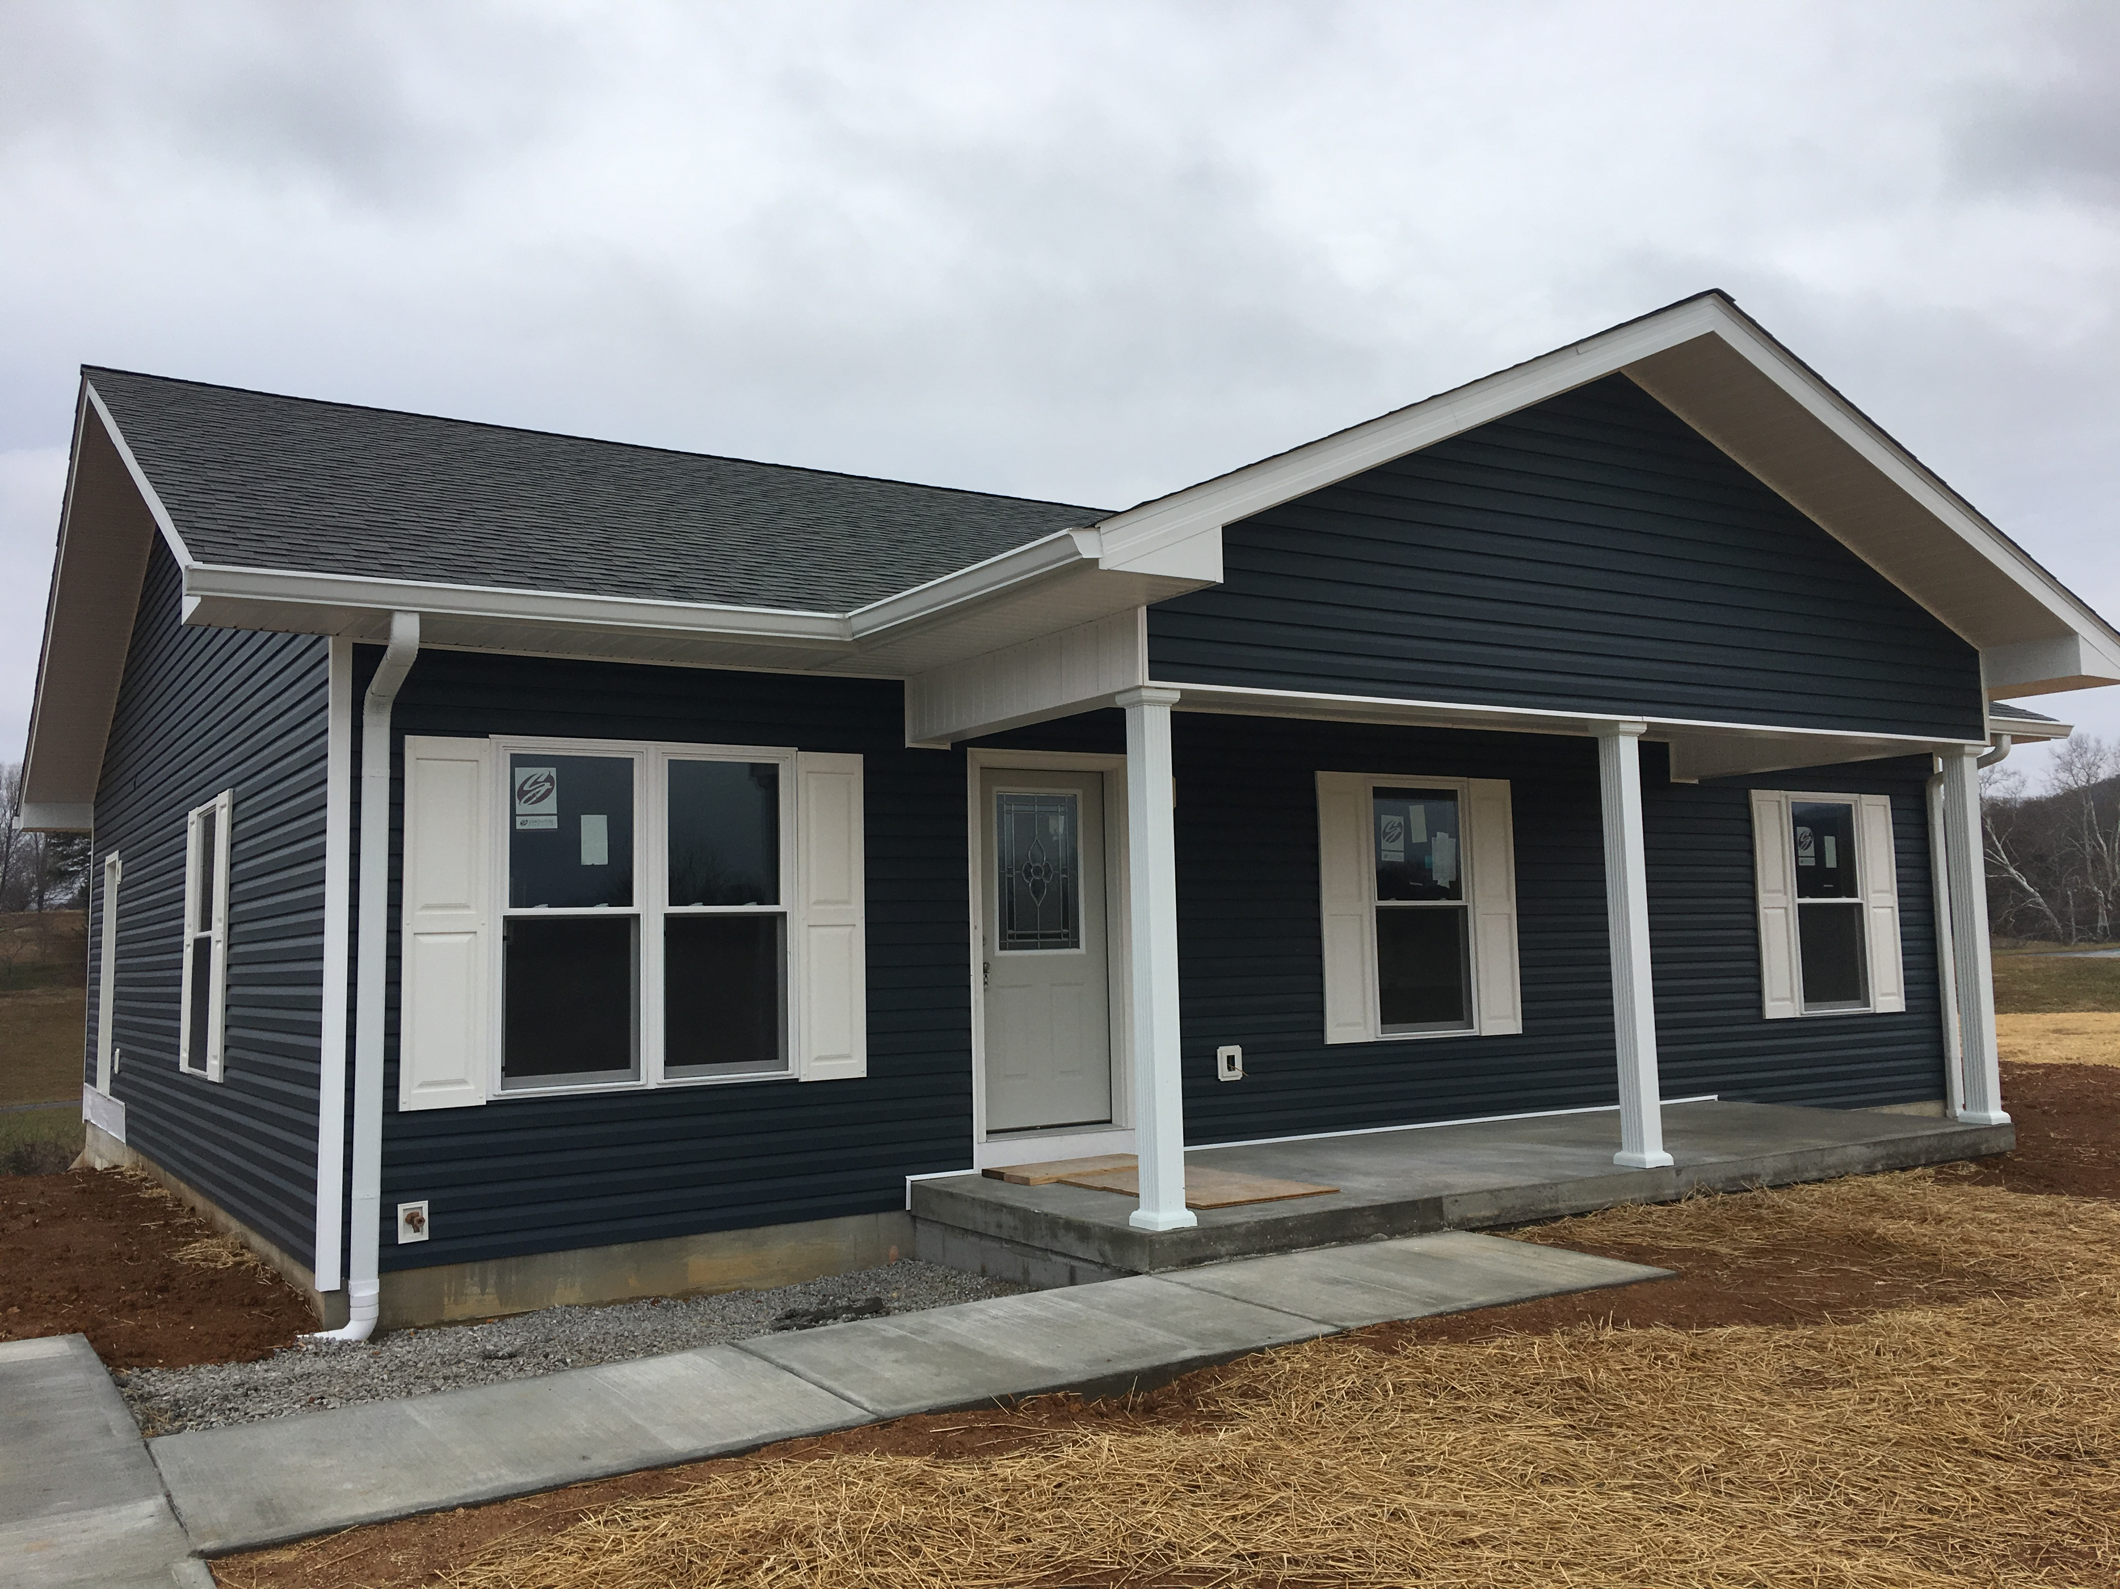
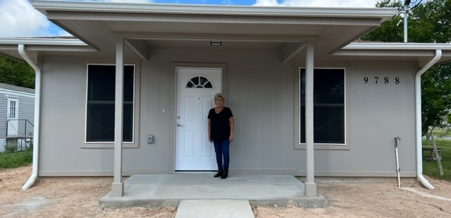
These homes were completed in San Juan, Texas under the sponsorship of Proyecto Azteca.

Slide 56
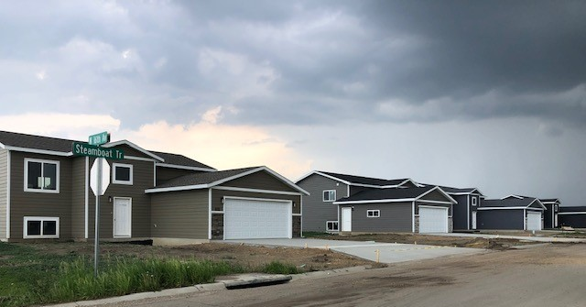
These homes were completed homes in South Dakota under the sponsorship of Inter-Lakes CAP.

Slide 57
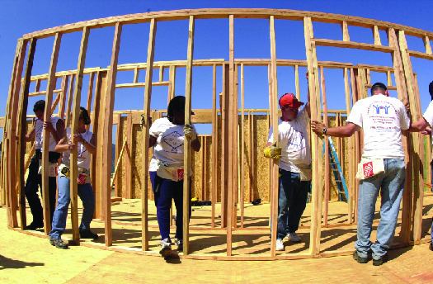
Self-Help Statistics
Currently about 82 grantees
Between 600-700 homes built or repaired per year
$25 million in 523 grants in Fiscal Year 2024
This Photo by Unknown Author is licensed under CC BY-NC

Slide 58
T&MA Contractors
Success of the Self-Help Housing Program in building 60,000 homes over the past 60 years is, in part, due to the expertise and commitment of the Technical & Management Assistance (T&MA) Contractors.
The Contractors aid the participating organizations in implementing the program.
There are four T&MA Contractors that oversee the program in four regions of the United States.
This Photo by Unknown Author is licensed under CC BY-NC

Slide 59

T&MA Contractor’s Responsibilities
Regional self-help contracts through USDA Rural Development.
These orgs provide assistance to potential and existing
self-help housing grantees.
Services provided:
Review and assist with your grant applications and amendments
Rural Development approved handbooks
Orientation and training
Program updates
Staff Training Workshops
Act as a resource for all your technical assistance

Slide 60
T&MA Contractor Websites
  www.NeighborGoodPartners.org
  www.liftca.org
  www.rcac.org
  www.fnph.org
FLORIDA NON-PROFIT HOUSING, INC.

Slide 61
T&MA Contractors
Florida Non-Profit Housing-covering Region I, the Southeast, including
the states of AL, FL, GA, MS, NC, SC, TN, Puerto Rico and the Virgin Islands
LIFT Community Action Agency-covering Region II, the South Central US,
Including the states of AR, KS, LA, Mo, ND, ME, NM, OK, SD, TX and WY
NeighborGood Partners-covering Region III, the Northeast and Midwest,
Including the states of CT, DE, IA, IL, IN, KY, MA, MD, ME, MI, MN, NH, NJ,
NY, OH, PA, RI, VA, VT, WI, WV
Rural Community Assistance Corporation-covering Region IV, the Western
US, including the states of AK, AZ, CA, CO, HI, ID, MT, NV, OR, UT, WA, and
the Western Pacific

Slide 62

Resources
Spotlight website
  www.selfhelphousingspotlight.org
Starting Point – Affordable Self Help Housing in Rural America YouTube Video
https://www.youtube.com/watch?v=CXlr8fVxJBg

Slide 63
Tips for Program Development
Shadow a current grantee
Check out the self-help housing spotlight website selfhelphousingspotlight.org
Start small
Use developed lots for first grant
Keep ownership and development of land simple
Be ready to start construction on day #1
Prepare financial systems for construction accounts and federal funds

Slide 64
Create & Maintain
A Good Relationship with USDA Rural Development
Respect
Communicate-KEY ingredient.
Understand expectations.
Stay focused on the common goal to improve the quality of life and increase the economic opportunity for Rural America.
The winners will be the Grantee, USDA Rural Development and most important-the Family being served.

Slide 65
Now What?
If your organization is interested:
  Contact the T&MA Contractor for your area.
  Conduct a Feasibility Study
      Helps determine if your organization and area are right for the program.
      Submit to T&MA Contractor with request to proceed with application training.
  Approval will be given by USDA Rural Development to proceed.
  Application assistance is provided.
  Grant funding is not guaranteed.

Slide 66




Thank you
Please contact a T&MA Contractor in your region.

